Slide 1
GTMI-AMBER Lab Research Roadmap （v2022）
Kan Wang, Ph.D.
Georgia Tech Manufacturing Institute
Georgia Institute of Technology

Slide 2
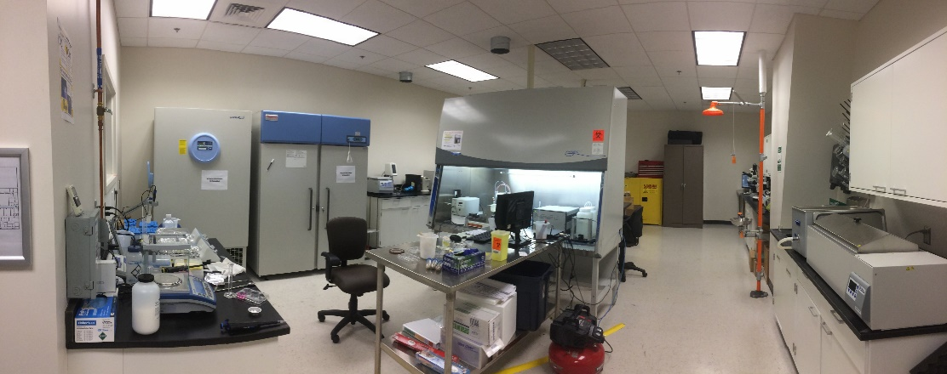
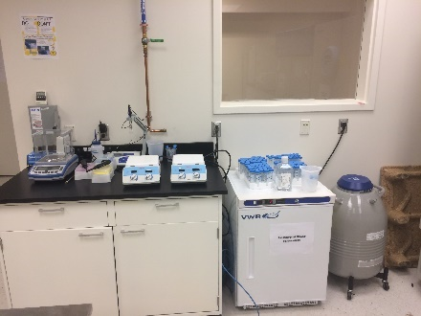
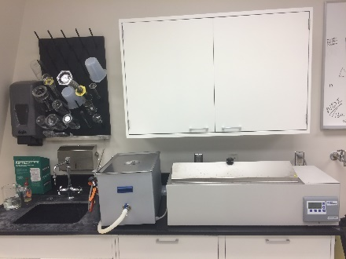
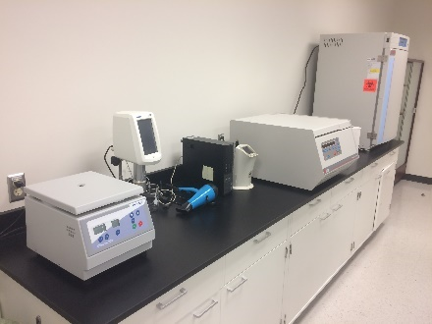
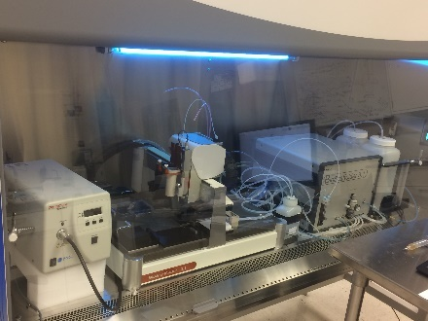
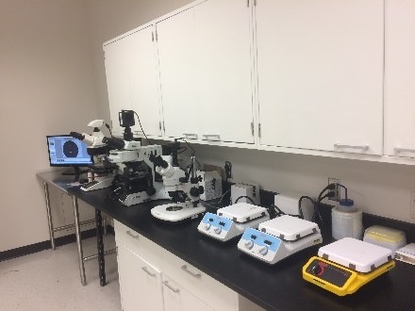
Facility
Physical address: 575 14th ST NW, Atlanta, GA
Home page: http://www.manufacturing.gatech.edu/additive-manufacturing-bio-engineering-research-amber

Slide 3
Individual Meeting - Research Plan
Individual Meeting - Research Plan & Proposal
Individual Meeting - Research Plan & Proposal
Mission and Strategy
Develop and leverage innovative advanced manufacturing technologies, data science methodologies, and advanced materials to accelerate and scale up bio engineering applications that are not achievable via conventional methods
Scale up and scale out
Predict and intercept unmet needs in tissue engineering
Emerging principles in design for advanced manufacturing
Current and future biomanufacturing industry and market needs
Biomimicry and physiology imitation
Advanced biocompatible and 3D printable materials
Innovations in bioprinting techniques
Enable functionality
Increase affordability
Notes:
Validate

Slide 4
Research Scope and Positioning
Bio-related Manufacturing Challenges
Medical
Non-medical
Cell Manufacturing
Tissue Engineering
Synthetic Biology
Biosensors
Supply Chain
Drug Screening/Testing
Implant/Transplant
Impedance Sensor
Simulation Based
Analytical Model Based
Prevascularization
Scaffolding
Biosensors
Printed Sensors
Cost Analysis
Priority
3D Vascular Model
Materials
Impedance Sensor
Calibration Free
Facility Optimization
Capacity Planning
Capillary Model
Fiber Based Scaffolding
Printed Sensors
Risk Assessment
Fiber Based Scaffolding
Calibration Free
AI/ML
Dynamic Scaffolds

Slide 5
AMBER Roadmap (Annual Update)
Impedance sensor fundamentals
Sensor design
Sensor array design
Biosensors
Ink selection
Printing optimization
Sensor
Sensor array generation I
Sensor array generation II
Prototype
Mathematic basis for calibration-free
Design tool for calibration-free
Cost model
Automation
Supply Chain
Priority queueing
Risk mitigation
Industry-relevant case study I
Industry-relevant case study II
Software beta test
Demand surge
Key Technologies
AI dispatcher
AI optimizer
AI planner
AI policy evaluator
Metamaterial Scaffold
Dynamic scaffold
Origami-based TE
Implants
Textile-based TE
Tissue engineering with texture
Tissue engineering with hierarchical microstructure
Smart scaffold
Prevascularization
Functional hydrogel
Multifunctional scaffold
Instrumented scaffold
3D microenvironment systems
Test with 3D MES
Drug Testing
IP disclosure
Identify target tissue system
Testing protocol development
Validation (animal test?)
Year 1
Year 2
Year 3
Year 4
Year 5+

Slide 6
GTMI-AMBER Lab Research Topics
1
Rapid fabrication of prevascular networks using alginate hollow fibers
Design and validate the textile platform based on wet-electrospun yarns for fabricating tissue scaffolds
Voxelated tissue engineering via 3D printed auxetic scaffold
Manufacturing Process Innovations
Increasing Affordability
1
2
An all-printed wireless, distributed sensor array platform for in-line, continuous monitoring of cell culture conditions in scale-up bioreactors
Calibration-free biosensor arrays for large scale biomanufacturing
Sensing and Data Processing Innovations
4
Increase Manufacturing Knowledge
2
3
Digital simulation framework for autologous cell therapy manufacturing and supply chain
Supply chain simulation for tissue engineering
5
Supply Chain Innovations
4
3D printing assisted virtual patient generation for surgical planning of transcatheter aortic valve replacement
Functional medical phantom
3
5
Artificial intelligence integrated simulation platform for future Manufacturing Management
Internet of things framework for cell manufacturing
Increase Manufacturing Readiness Level
*Blue entries are future research topics
Notes:
Scalability and Functionality

Slide 7
Research Positioning
IMPACT
OUTCOMES
AMBER Lab (GTMI)
NEEDS
Increase TE capability
Scaffold material by design
Organ source for transplant
Less time on the waiting list
Just-in-time delivery
Improved cell proliferation
Additive manufacturing technologies
Computer aided scaffold design and modeling
Less life losses due to organ shortage
Demand surge in emergency
Increased production rate
Scale-up organ manufacturing
Reduced medical costs
Closed loop process control
Affordable transplantation
Real time monitoring
Hybrid and multifunctional biomaterials
Miniaturized and integrated biosensors
Less variation between batches
Promoted down-stream industry

Slide 8
APPENDIX I
List of Achievements

Slide 9
Academic Output
Journal Papers:
Kan Wang, Aaron D. Levine, Bruce L. Levine, Ben Wang, and Chip White. "Commercial Autologous Cell Therapy: The Value of Real-Time Patient and Therapy Data." Current Opinion in Biomedical Engineering (2022): 100389.
Zhaonan Liu, Jialei Chen, Kan Wang, Ben Wang, and Chuck Zhang. "Current status and opportunities in adaptive data analysis for therapeutic cell manufacturing." Current Opinion in Biomedical Engineering 20 (2021): 100351.
Chen Jiang, Kan Wang, Yi Liu, Chuck Zhang, and Ben Wang. "Application of Textile Technology in Tissue Engineering: A review." Acta Biomaterialia (2021).
Chen Jiang, Kan Wang, Yi Liu, Chuck Zhang, and Ben Wang. "Textile-based sandwich scaffold using wet electrospun yarns for skin tissue engineering." Journal of the Mechanical Behavior of Biomedical Materials (2021): 104499.
Chen Jiang, Kan Wang, Yi Liu, Chuck Zhang, and Ben Wang. "Using Wet Electrospun PCL/Gelatin/CNT Yarns to Fabricate Textile-Based Scaffolds for Vascular Tissue Engineering." ACS Biomaterials Science & Engineering (2021).
Chen Jiang, Kan Wang, Xuzhou Jiang, Chuck Zhang, Ben Wang. “Quantitative Investigation of the Process Parameters of Electrohydrodynamic Direct-writing and Their Effects on Fiber Surface Roughness and Cell Adhesion” Polymers 12, no. 11 (2020): 2475.
Kan Wang, Yi Liu, Junxuan Li, Chip White, Ben Wang, Bruce L. Levine. “Modeling the Effects of Supply Chain and Operator Disruptions on Cell Therapy Manufacturing Facility Operations During the COVID-19 Pandemic”, American Pharmacerutical Review, (2020)
Yi-Wen Chen, Kan Wang, Ming-You Shie, Chia-Che Ho, Chia-Tze Kao, Hooi Yee Ng. “Cyclic tensile stimulation enrichment of Schwann cell-laden auxetic hydrogel scaffolds towards peripheral nerve tissue engineering”, Materials and Design, (2020), 108982
Shuai Li, Kan Wang, Xuzhou Jiang, Qingxi Hu, Chuck Zhang, and Ben Wang. "Rapid Fabrication of Ready-to-Use Gelatin Scaffolds with Prevascular Networks Using Alginate Hollow Fibers as Sacrificial Templates." ACS Biomaterials Science & Engineering 6, no. 4 (2020): 2297-2311.
Jialei Chen, Yujia Xie, Kan Wang, Chuck Zhang, Mani A. Vannan, Ben Wang, and Zhen Qian. "Active image synthesis for efficient labeling." IEEE Transactions on Pattern Analysis and Machine Intelligence 43, no. 11 (2020): 3770-3781.
Kan Wang, Ben Wang, Aaron D Levine, and Chip White, “Supply chain challenges and issues facing the autologous cell manufacturing industry” Cell & Gene Therapy Insights (2020) 6(2), 137-141.
Kan Wang, Yi Liu, Junxuan Li, Ben Wang, Reid Bishop, Chip White, Amritava Das et al. "A multiscale simulation framework for the manufacturing facility and supply chain of autologous cell therapies." Cytotherapy 21, no. 10 (2019): 1081-1093.
(Continued on the next page)

Slide 10
Academic Output (Cont’d)
Li, Shuai, Kan Wang, Qingxi Hu, Chuck Zhang, and Ben Wang. "Direct-write and sacrifice-based techniques for vasculatures." Materials Science and Engineering: C (2019): 109936.
Yen-Hong Lin, Tsan-Yu Chuang, Wei-Hung Chiang, I-Wen Peter Chen, Kan Wang, Ming-You Shie, and Yi-Wen Chen. "The synergistic effects of graphene-contained 3D-printed calcium silicate/poly-ε-caprolactone scaffolds promote FGFR-induced osteogenic/angiogenic differentiation of mesenchymal stem cells." Materials Science and Engineering: C (2019): 109887.
Jialei Chen, Yujia Xie, Kan Wang, Chuck Zhang, Mani A. Vannan, Ben Wang, and Zhen Qian. "AVP: Physics-informed Data Generation for Small-data Learning." arXiv preprint arXiv:1902.01522 (2019).
Cuidi Li, Kan Wang, Xiaojun Zhou, Tao Li, Yan Xu, Lei Qiang, Mingzheng Peng et al. "Controllable fabrication of hydroxybutyl chitosan/oxidized chondroitin sulfate hydrogels by 3D bioprinting technique for cartilage tissue engineering." Biomedical Materials (2018).
Jialei Chen, Kan Wang, Chuck Zhang, and Ben Wang. "An efficient statistical approach to design 3D-printed metamaterials for mimicking mechanical properties of soft biological tissues." Additive Manufacturing 24 (2018): 341-352.
Yi-Wen Chen, Yu-Fang Shen, Chia-Che Ho, Joyce Yu, Yuan-Haw Andrew Wu, Kan Wang, Cheng-Ting Shih, and Ming-You Shie. "Osteogenic and angiogenic potentials of the cell-laden hydrogel/mussel-inspired calcium silicate complex hierarchical porous scaffold fabricated by 3D bioprinting." Materials Science and Engineering: C (2018).
Kan Wang, Chia-Che Ho, Chuck Zhang, and Ben Wang. “A Review on 3D Printing of Functional Structures for Medical Phantoms and Regenerated Tissues/Organs Applications”, Engineering, 3 no. 5 (2017): 653-662.
Zhen Qian, Kan Wang, Shizhen Liu, Xiao Zhou, Vivek Rajagopal, Christopher, Meduri, James R. Kauten, Yung-Hang Chang, Changsheng Wu, Chuck Zhang, Ben Wang, and Mani A. Vannan, “Quantitative Prediction of Paravalvular Leak in Transcatheter Aortic Valve Replacement Based on Tissue-Mimicking 3D Printing”, Journal of the American College of Cardiology: Cardiovascular Imaging, 10.7 (2017): 719-731.
Zhen Qian, Kan Wang, Yung-Hang Chang, Chuck Zhang, Ben Wang, Vivek Rajagopal, Christopher Meduri et al. "3-D printing of biological tissue-mimicking aortic root using a novel meta-material technique: Potential clinical applications." Journal of the American College of Cardiology 67, no. 13 (2016): 7.
(Continued on the next page)

Slide 11
Academic Output (Cont’d)
Kan Wang, Changsheng Wu, Zhen Qian, Chuck Zhang, Ben Wang, and Mani A. Vannan. “Dual-material 3D printed metamaterials with tunable mechanical properties for patient-specific tissue-mimicking phantoms.” Additive Manufacturing (2016), vol. 12 Part A: 31–37
Yu-Fang Shen, Chia-Che Ho, Ming-You Shie, Kan Wang, and Hsin-Yuan Fang. "Hinokitiol-Loaded Mesoporous Calcium Silicate Nanoparticles Induce Apoptotic Cell Death through Regulation of the Function of MDR1 in Lung Adenocarcinoma Cells." Materials 9, no. 5 (2016): 306.
Kan Wang, Yuanshuo Zhao, Yung-Hang Chang, Zhen Qian, Chuck Zhang, Ben Wang, Mani A. Vannan, and Mao-Jiun Wang. “Controlling the mechanical behavior of dual-material 3D printed meta-materials for patient-specific tissue-mimicking phantoms.” Materials & Design 90 (2016): 704-712.
Yi-Wen Chen, Tuan-Ti Hsu, Kan Wang, and Ming-You Shie. “Preparation of the fast setting and degrading Ca–Si–Mg cement with both odontogenesis and angiogenesis differentiation of human periodontal ligament cells.” Materials Science and Engineering: C 60 (2016): 374-383.
Book Chapters:
Chen, Jialei, Yujia Xie, Kan Wang, Zih Huei Wang, Geet Lahoti, Chuck Zhang, Mani A. Vannan, Ben Wang, and Zhen Qian. "Generative invertible networks (GIN): pathophysiology-interpretable feature mapping and virtual patient generation." In International Conference on Medical Image Computing and Computer-Assisted Intervention, pp. 537-545. Springer, Cham, 2018.
Kan Wang, Chuck Zhang, Ben Wang, Mani A. Vannan, and Zhen Qian. "13 Sensor-Enabled 3D Printed Tissue-Mimicking Phantoms: Application in Pre-Procedural Planning for Transcatheter Aortic Valve Replacement." Cardiovascular Imaging and Image Analysis (2018): 283. Published by CRC Press, Taylor & Francis Group, LLC. Boca Raton, FL.
Awards:
TechConnect Innovation Award (2018)
R&D 100 Award (2018)
IEEE Transactions on Automation Science and Engineering Best Paper Award (2018)
Featured paper in Elsevier’s Biomedical Engineering Collection (2019)

Slide 12
Supported Projects (External Funded)
Ongoing projects:
NIST-MFGUSA RACER: Robotics and Automation Decision framework for Agility and Resilience (RADAR) (Total: $5,000,000; GT: $720,898)
BioMADE: Stress testing supply chains and their ecosystems for levels of trust, security, resilience, agility, and competitiveness ($250,000)
Raytheon: Resilient Additive Manufacturing Platform (RAMP) ($175,000)
Finished projects:
NASA: Model-based INtelligent Decisions for Higher Innovation Value and Efficiency (MINDHIVE)
BioFabUSA: Supply Chain and Process Modeling Algorithms, Methods, and Tools for Tissue Manufacturing and Distribution
NSF-CMaT: Development of Real-Time Biosensors for Monitoring Cell and Culture Attributes during Manufacturing
NSF-CMaT: Novel Supply Chain and Process Modeling for Cell Therapy Manufacturing and Distribution
FDA: Data Enabled Automation for the Improved Efficiency, Yield, and Reproducibility of the Manufacturing of Human Umbilical Cord Tissue Mesenchymal Stromal Cells for Clinical Therapeutic Use
Marcus: An All-Printed Wireless, Distributed Sensor Array Platform for In-Line, Continuous Monitoring of Cell Culture Conditions in Scale-Up Bioreactors
Pending proposals:
DARPA-RSDN: Stress Testing sUpply and Demand sYstem (STUDY) (Total: $6,000,000; GT: $3,600,000)
NSF-Future Manufacturing: Personalized Regenerative Innovations in Medicine and Education (PRIMEd) for Future Biomanufacturing: Using Real-Time Patient and Therapy Data to Improve Patient and Societal Benefit (Total: $3,000,000; GT: $2,560,000)

Slide 13
APPENDIX II
1-Slide Introductions of AMBER Projects

Slide 14
1
Manufacturing Process Innovations

Slide 15
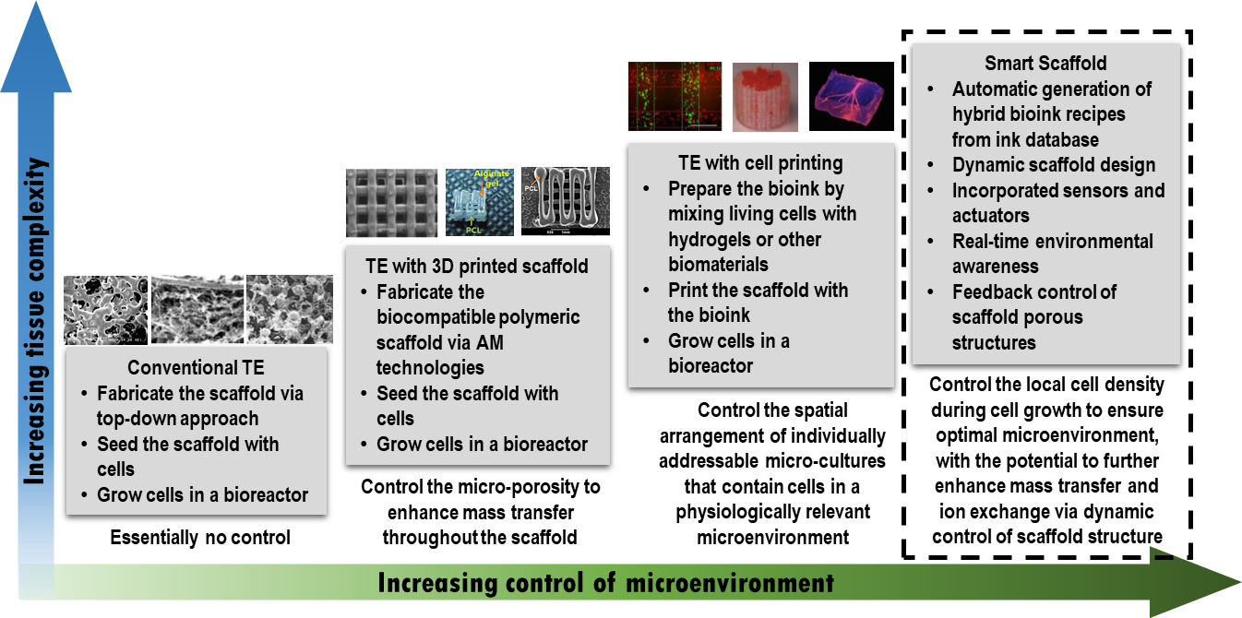
Our Vision: Smart Scaffold for Tissue Engineering

Slide 16
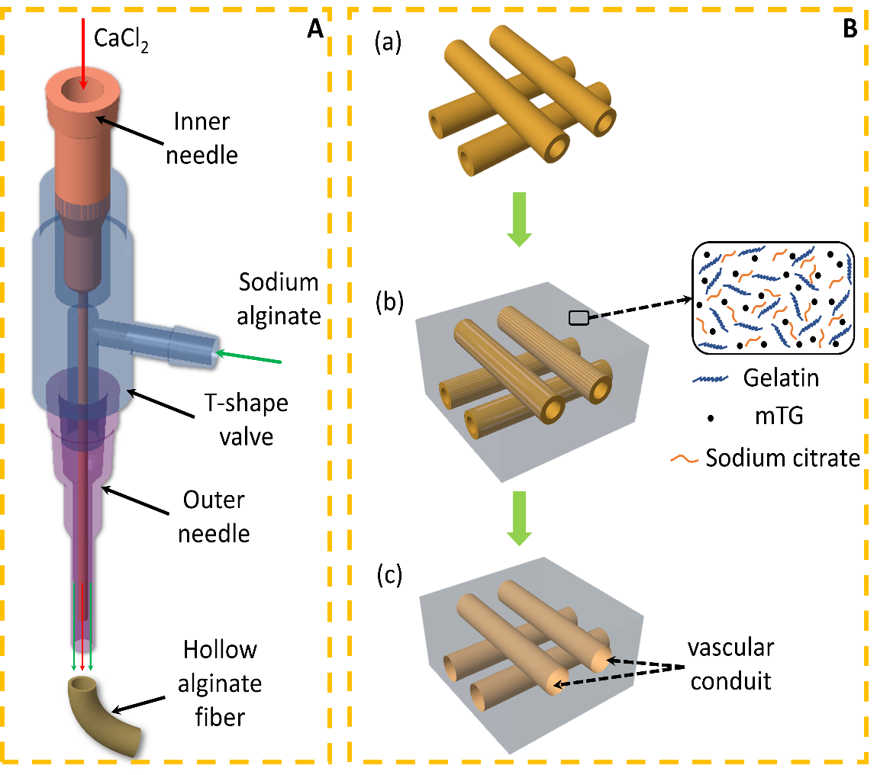
Rapid Fabrication of Prevascular Networks using Alginate Hollow Fibers
Project goal: Develop a facile, sacrifice-based method for fabricating branching and interconnected prevascular networks that can provide oxygen, nutrients, and wastes delivery for cells in large volume tissue engineering scaffolds.
A. The coaxial nozzle used for extruding hollow alginate fibers. B. Schematic diagram of fabricating 3D branched prevascular network in gelatin scaffolds. (a)Printed sacrificial template. (b) Sacrificial template in the mixture of quasi-crosslinking gelatin and sodium citrate. (c) Prevascular networks after dissolving of the sacrificial template during the crosslinking process.
ACS Biomaterials Science & Engineering 6.4 (2020): 2297-2311.
Materials Science and Engineering: C 104 (2019): 109936.

Slide 17
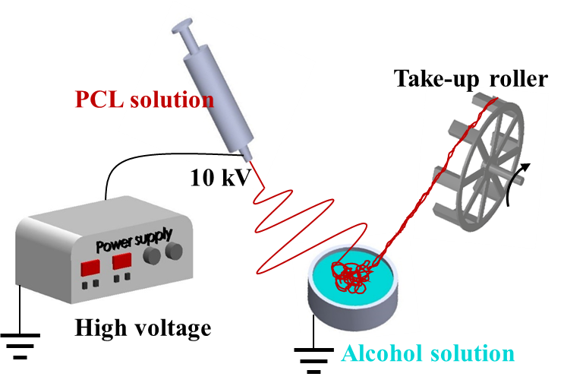
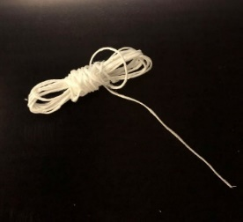
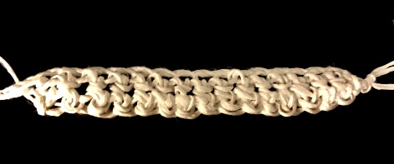
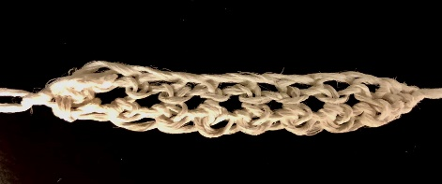
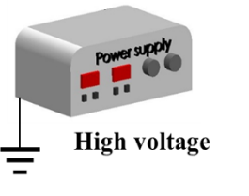
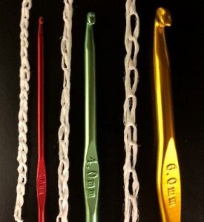
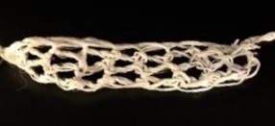
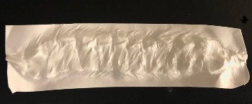
Design and validate the textile platform based on wet-electrospun yarns for fabricating tissue scaffolds
Project goal: Integrate textile technology in tissue engineering to mimic the structural, mechanical, and biological properties of human tissues.
2 mm hook
4 mm hook
6 mm hook
10 mm
Preliminary results:
A new category of composite scaffolds was designed and fabricated for mimicking human skin tissue from the three-layer architecture to mechanical properties.
The strain-stiffening property of human soft tissues can be simulated by introducing the wavy structures of textile patterns in scaffolds.
The effect of process parameters during wet electrospinning on fabricated yarns’ crystallinity degree was investigated to mimic the rigid and elastic components in soft tissues.
Acta Biomaterialia 128 (2021): 60-76.
Journal of the Mechanical Behavior of Biomedical Materials 119 (2021): 104499.
ACS Biomaterials Science & Engineering 7.6 (2021): 2627-2637.
Polymers 12.11 (2020): 2475.

Slide 18
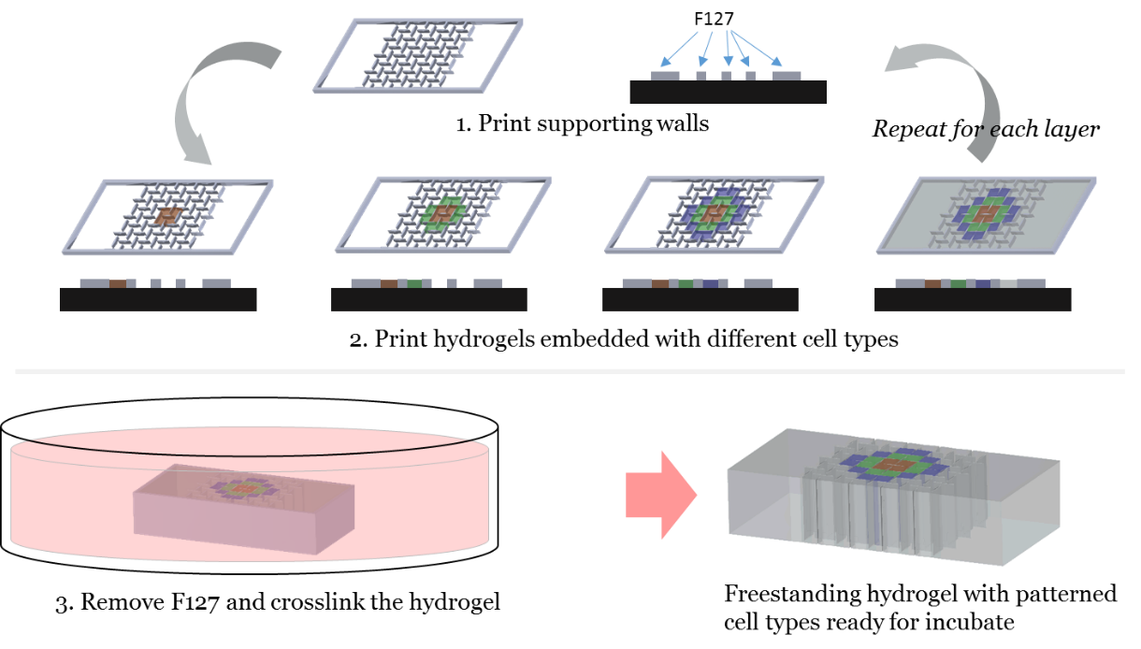
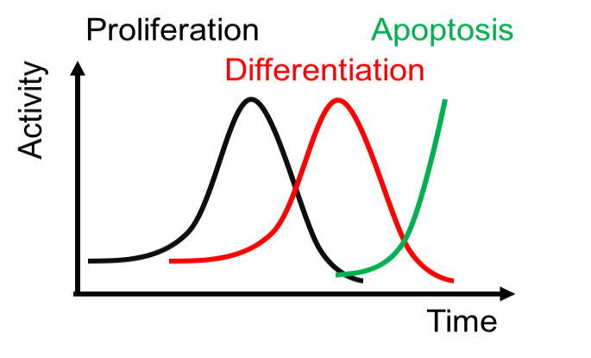
Voxelated Tissue Engineering via 3D Printed Auxetic Scaffold
Project goal: Develop a universal tissue engineering process based on real-time controlled dynamic scaffolds for large, solid tissues and organs.
Auxetic metamaterials may serve as a viable method to divide a large scaffold into small compartments
The negative Poisson’s ratio of the auxetic scaffold provides a chance to control the volume of the scaffold
When stretched, channels are formed among the compartments to allow material exchange
When compressed, the scaffold switches to a “closed mode” that eliminates all internal voids
The microfluidic flows through the scaffold can also be regulated via dynamic controls
Biomedical Materials 14.2 (2019): 025006.
Materials & Design 195 (2020): 108982.
US Patent 11,124,763, 2021

Slide 19
2
Sensing and Data Processing Innovations

Slide 20
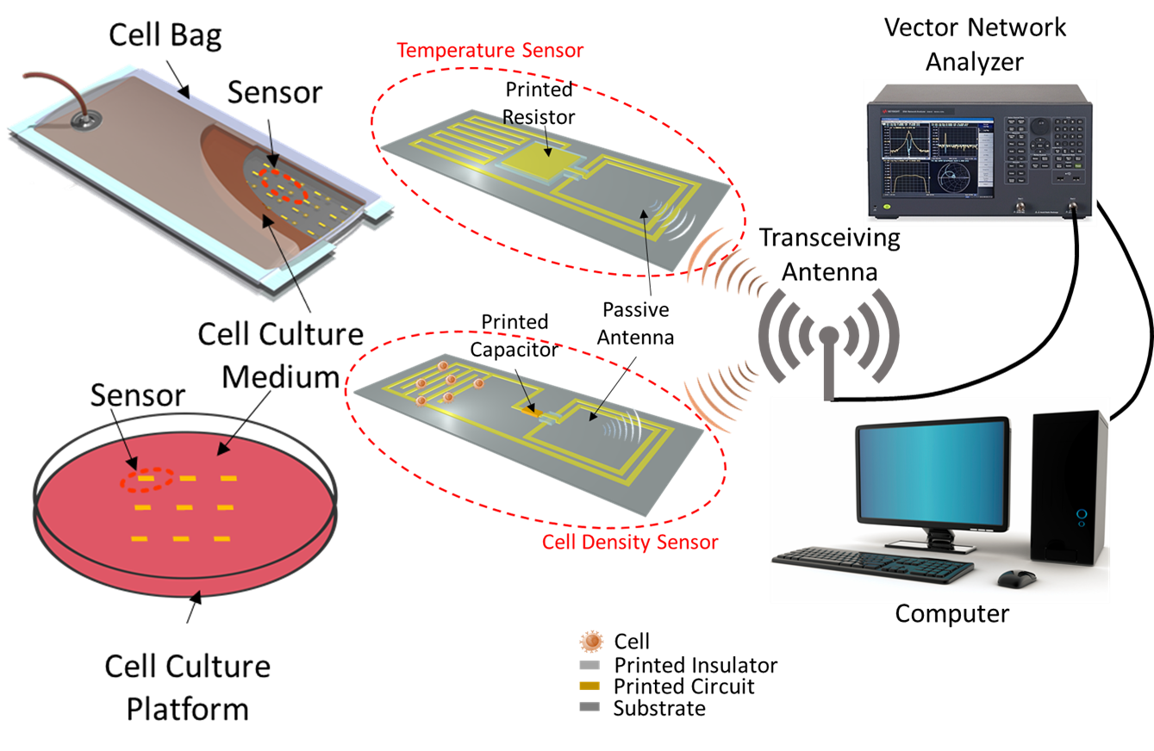
An All-Printed Wireless, Distributed Sensor Array Platform for In-Line, Continuous Monitoring of Cell Culture Conditions in Scale-up Bioreactors
Project goal: Leverage the latest printed electronics technology to design, fabricate, and validate a wireless, distributed sensor array platform for in-line monitoring of cell culture conditions in scale-up bioreactors.
Current Opinion in Biomedical Engineering 20 (2021): 100351.
IEEE Transactions on Pattern Analysis and Machine Intelligence 43.11 (2020): 3770-3781.

Slide 21
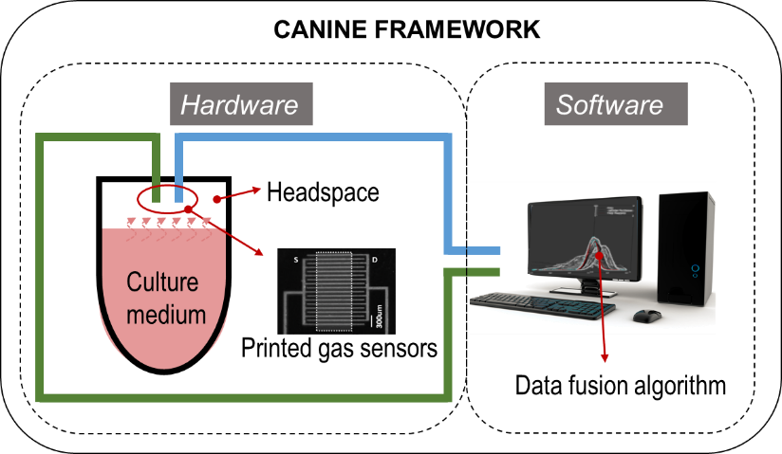
Calibration-Free Biosensor Arrays for Large Scale Biomanufacturing
Project goal: Develop an additive manufacturing assisted biosensing and data analytic platform to eliminate the need of calibration in cell manufacturing process monitoring and provide high fidelity, cross-validated signal.
Cross-validated Ammonia and Nitric-dioxide Index Number Estimator (CANINE)

Slide 22
3
Supply Chain Innovations

Slide 23
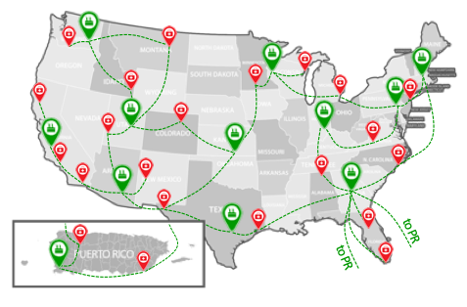
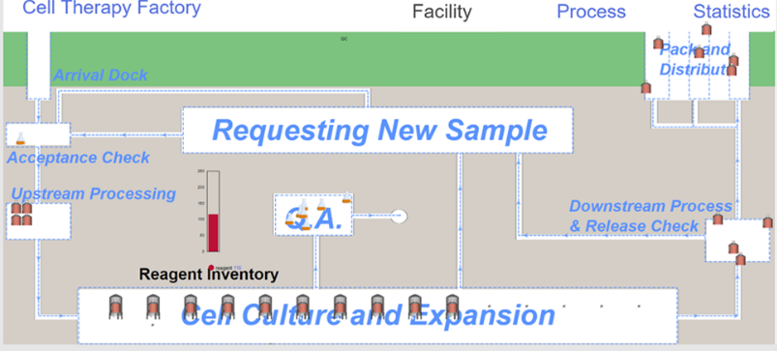
Digital Simulation Framework for Autologous Cell Therapy Manufacturing and Supply Chain
Project goal: Develop and apply a digital simulation framework for autologous cell therapy manufacturing and supply chain to generate actionable insights that lead to improved manufacturing process and transform Autologous cell therapy (AuCT) manufacturing into a large-scale, lower-cost, reproducible, and high-quality engineered process, for broad industry and clinical use.
Cytotherapy 21.10 (2019): 1081-1093.
Cell & Gene Therapy Insights (2020) 6(2), 137-141
American Pharmacerutical Review, (2020)

Slide 24
4
Manufacturing Process Innovations
+
Sensing and Data Processing Innovations

Slide 25
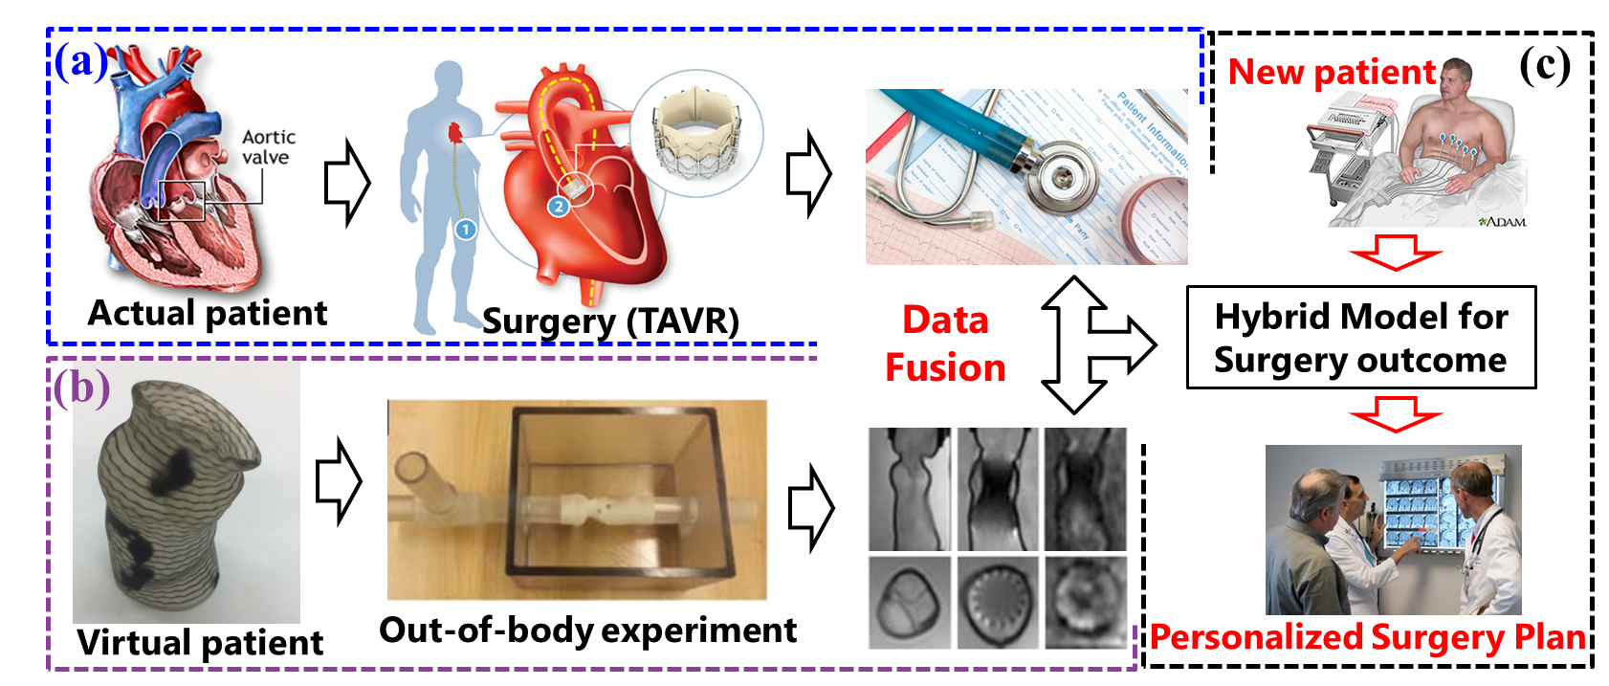
3D Printing Assisted Virtual Patient Generation for Surgical Planning of Transcatheter Aortic Valve Replacement
Project goal:
Develop a framework to generate virtual patient models and obtain additional data set
Conduct data fusion of actual and virtual patient to enhance personalized surgical planning
Additive Manufacturing 24 (2018): 341-352.
Tissue Engineering: Part A, vol. 23 (2017), pp. S64-S65
Journal of the American College of Cardiology: Cardiovascular Imaging, 10.7 (2017): 719-731.
The International Journal of Advanced Manufacturing Technology 88.5-8 (2017): 1889-1901
U.S. Patent No. 10,726,742. 28 Jul. 2020
Journal of the American College of Cardiology 67, no. 13 (2016): 7.
Additive Manufacturing (2016), vol. 12 Part A: 31–37
Materials & Design 90 (2016): 704-712.
TechConnect 2018 Innovation Award
2018 R&D 100 Award

Slide 26
5
Sensing and Data Processing Innovations
+
Supply Chain Innovations

Slide 27
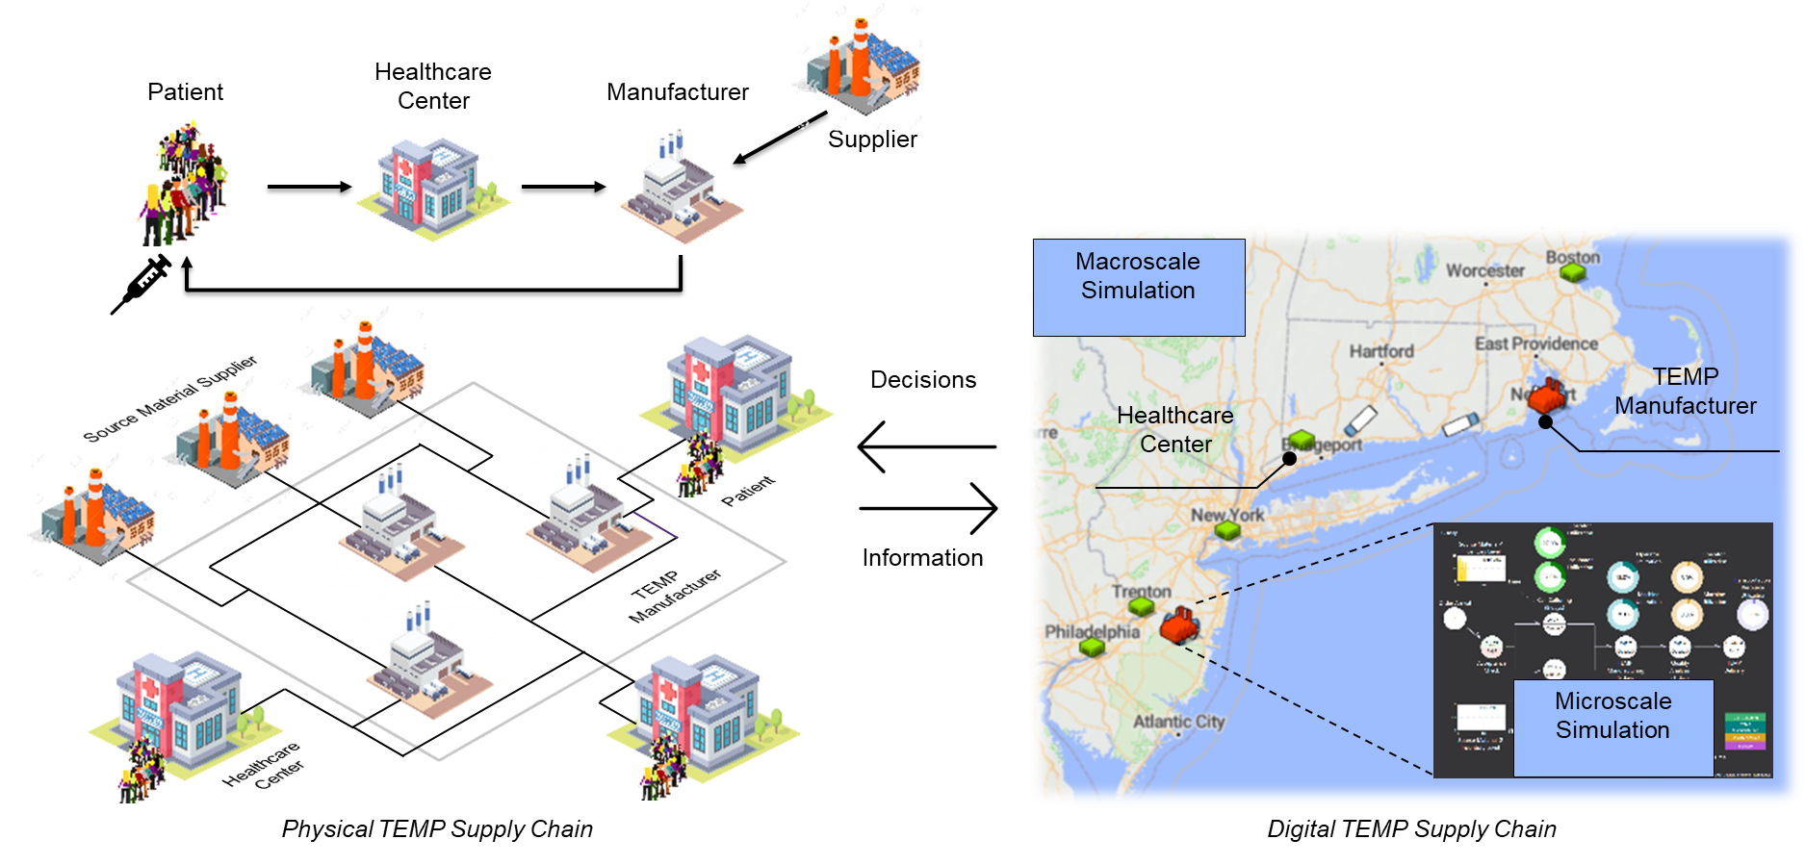
Artificial Intelligence Integrated Simulation Platform for Future Manufacturing Management
Project goal: Develop a simulation-based decision support system for tissue-engineered medical product end-to-end supply chains to maximize patient benefits
Current Opinion in Biomedical Engineering (2022) in press
Software copyrighted
Notes:
Howard

