Slide 1
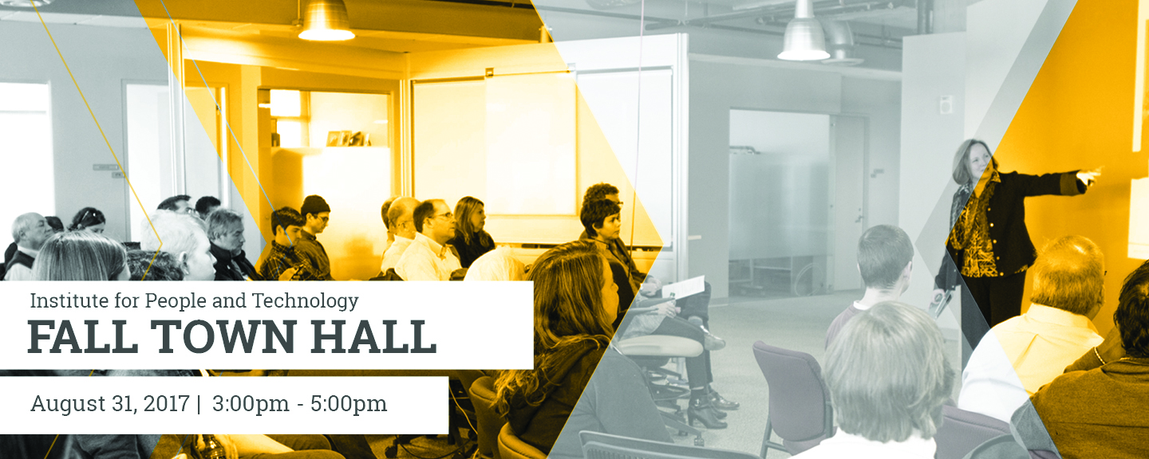
IPaT Fall Town Hall

Slide 2
Townhall Agenda for Today
Learn a bit about IPaT.
Vision. Mission. Values. IRI-ness.
Discuss research pillars and emerging initiatives for next year.
Discover connections and opportunities 💰
Meet new people and connect after a “relaxing” summer ☺
email: ipat@gatech.edu

Slide 3
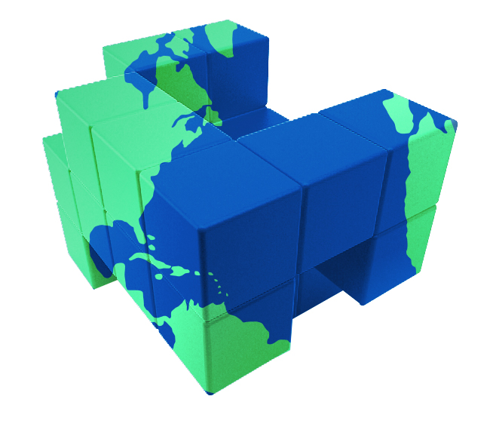
IPaT’s Vision
Shaping the future of human-centered systems, environments and technologies …
to promote
fulfilling, healthy and productive lives
Notes:
Need some visual treatment here

Slide 4

IPaT Research Priorities
Life Long Health and Wellbeing
Smart Cities and Inclusive Innovation
Platforms and Services for
Socio-Technical Systems
Shaping the Human Technology Frontier
Notes:
Need visual here

Slide 5

IPaT Values
One GT
Innovation
We will operate collaboratively by sharing knowledge and resources, all for the greater good of Georgia Tech.
We will support a culture of creativity, thought leadership and boundary-pushing ideas, and be unafraid of failure.
Trusted Partner
Diversity
We will be transparent, meet deadlines, and work together to enhance and grow valuable relationships on and off campus.
We will recognize, respect, and embrace inclusion and fairness throughout all aspects of our research, practice and operations.

Slide 6

IPaT’s Mission
Catalyze interdisciplinary research between faculty, students, and industry.
Provide the continuity and capacity to address societal challenges.
Advocate for socio-technical change that improves the human condition.
Educate human-centered engineers, scientists, designers, business leaders, and policy makers.

Slide 7

Key IPaT Goals and Objectives (IRI 2.0)
Catalyze interdisciplinary research between faculty, students, and industry.
Provide the continuity and capacity to address societal challenges.
Develop a vision and strategic plan
Communicate the broad research vision to all members
Work closely with colleges, schools, IRCs/CTRs, and GTRI to coordinate interdisciplinary research efforts, including the support and retention of faculty members
​Catalyze new research directions, maintain a dynamic research portfolio, and facilitate the formation of interdisciplinary teams, including enabling and incubating the development of new IRCs and CTRs​
Act as an effective focal point for interactions with external partners
Coordinate with GTRC, EI2 and Government Relations on (i) research and development, (ii) technology commercialization, and (iii) economic development and entrepreneurship
​
Provide leadership and resources to facilitate the development of large-scale multi-investigator extramural grant programs
Manage and support research space, including core resources and facilities, as appropriate to the research field
Notes:
Can you make this more readable?

Slide 8
Key IPaT Goals and Objectives (IRI 2.0)
Advocate for socio-technical change that improves the human condition.
Educate engineers, scientists, designers, business leaders, & policymakers.
Organize and articulate national and international thought leadership
Enable the creation of funding opportunities through policy participation and leadership in the development of national and state science and technology priorities
Provide forums for knowledge exchange between faculty, students and external partners
Create opportunities for professional education
Enhance curricula and student experience through student research opportunities, industry innovation competition, research project teams, and access to internship and job opportunities.
Notes:
Can you make this more readable?

Slide 9
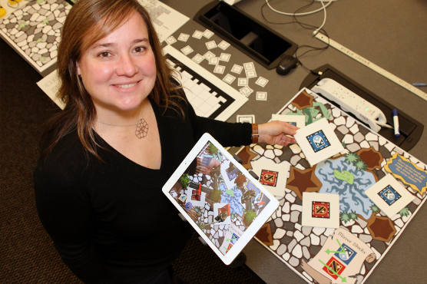
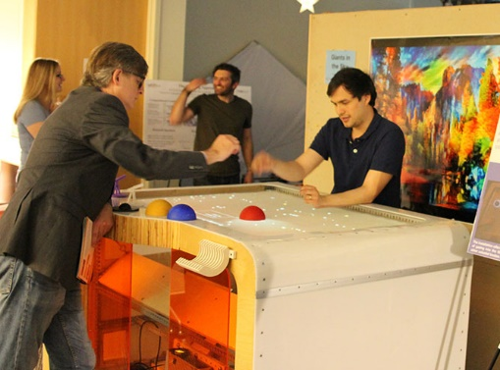
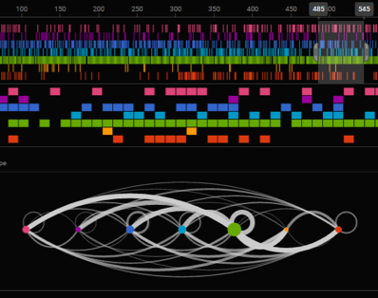
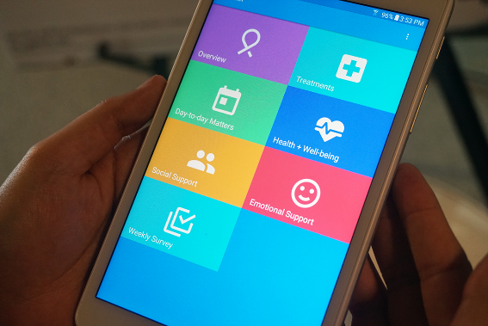
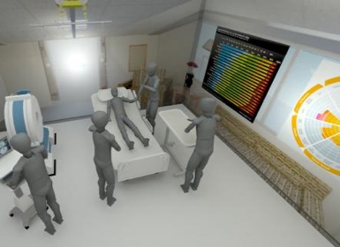
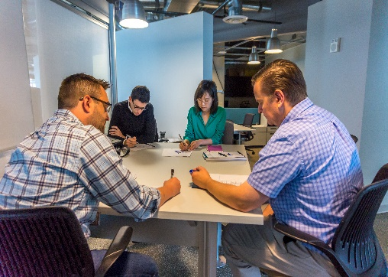
IPaT Research Pillars
Life Long Health and Wellbeing
Smart Cities and Inclusive Innovation
Platforms and Services for
Socio-Technical Systems
Shaping the Human Technology Frontier
email: ipat@gatech.edu
Notes:
Need visual here

Slide 10
IPaT Research Pillars: Faculty Co-Directors
Life Long Health and Wellbeing
George P. Burdell and Buzz
Smart Cities and Inclusive Innovation
Jennifer Clark and Debra Lam
Platforms and Services for
Socio-Technical Systems
Rahul Basole and Russ Clark
Shaping the Human Technology Frontier
Keith Edwards and Maribeth Gandy
Notes:
Need visual here

Slide 11

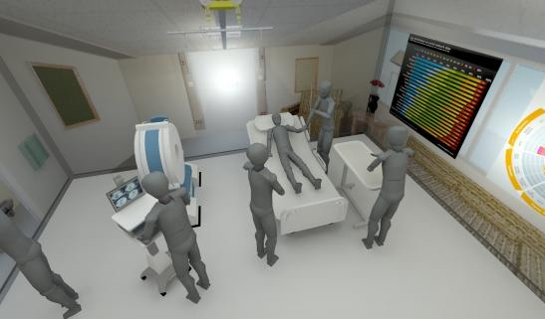
Life Long Health and Wellbeing
Pediatric Healthcare
Healthy Aging
Healthcare Delivery
Mobile Health & Social Computing
Healthcare Environments
Healthcare Access and Disparities
Universal Access & Assistive Tech

Slide 12
Life Long Health and Wellbeing
“Last mile impact”
Policy, Wireless and TechSAge RERC
CDC Epicenter : Ebola Treatment
Endpoints (patients, providers)
Behavior change
Translational diabetes pilot grants
Ramp up mobile health
IPaT working group (Beth, Jeremy)
Aging
TechSAge RERC, DATHA
Aware Home, GTRI Home Lab
Optimal Aging (Hertzog)
Pediatrics
Analytics. Upcoming call for grants.
Care experience: Pediatric cancer
Infrastructure
PHDI capabilities
Compliance (HIPAA, NIST, CMS)
Pediatric Healthcare
Healthy Aging
Healthcare Delivery
Mobile Health & Social Computing
Healthcare Environments
Healthcare Access and Disparities
Universal Access & Assistive Tech

Slide 13

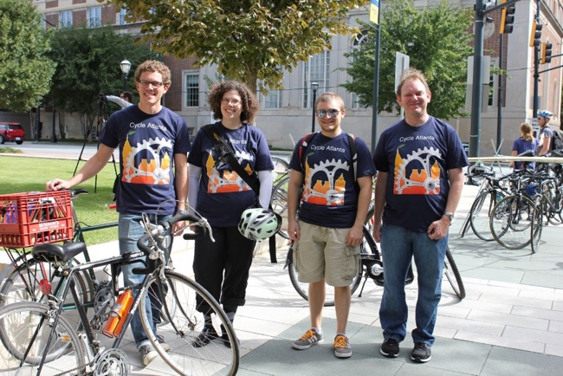
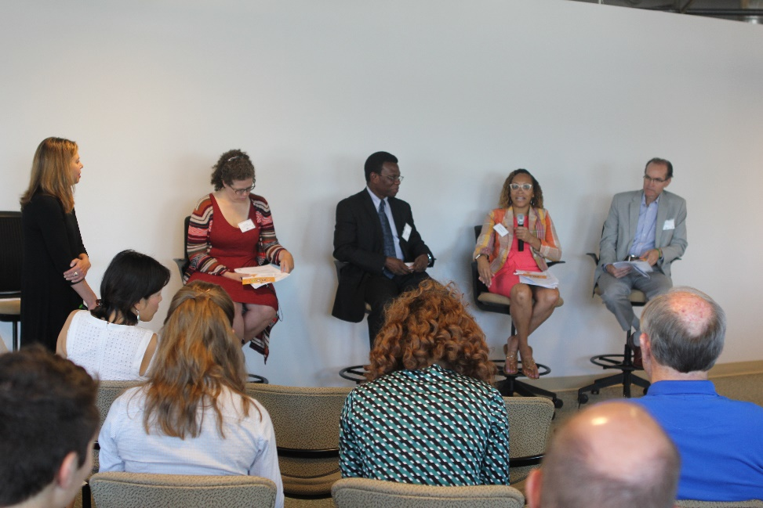
Smart Cities and Inclusive Innovation
Resilience and Response
Public Safety
Mobility
Urban Innovation
Community Engagement
Smart Tech for Rural Communities

Slide 14
Smart Cities and Inclusive Innovation
Smart ATL (City of Atlanta)
North Ave Launch
Transportation and mobility
Public safety
Water (coming in 2018)
GA Smart Communities
July workshop; Upcoming ARC conference
Smart Campus
Partnership with facilities
Smart City data support
Pilot grants, campus data
Seed Grants
Campus twin
Westside community engagement
National Leadership
Resilience and Response
Public Safety
Mobility
Urban Innovation
Community Engagement
Smart Tech for Rural Communities

Slide 15
Smart Cities and Inclusive Innovation
SEPTEMBER SMART CITY EVENTS:
MetroLab Summit
Sept 13-15 @ Academy of Medicine
Lam, Zegura and LeDantec are GT speakers.
GT faculty, staff & students qualify for
discounted registration (code: SUMMIT250).
North Avenue Corridor Launch
Sept 14 @ Ponce City Market
Mayor Reed and President Peterson will speak
City of Atlanta “Experience the Smart City”
Sept 15 @ Ponce City Market, CoA showcase as part of Atlanta’s Smart City Week
POLIS Civic Tech/Smart Cities Speaker Series
Sept 17 @ General Assembly a speaker series on civic tech and smart cities will start.
ConnectATL Summit
Sept 22 @ GTHotel and Conference Center
Atlanta Regional Commission is hosting ConnectATL, a summit on the future of mobility.

Slide 16

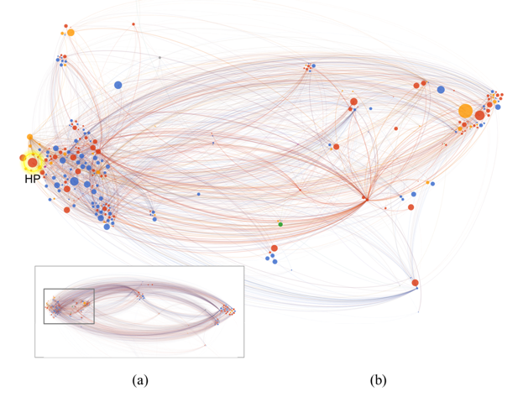
Platforms and Services for
Socio-Technical Systems
IoT / Software defined networking
Future Wireless
Analytics for healthcare, diagnosis, delivery and efficiency
Visual Analytics
Enterprise Simulation
Notes:
Visual Analytics for Strategic Decision Making (this refers to all things ecoxight related -- Adobe, Intel, KPMG)
FHIR-Enabled Population Health Analytics (fhirplug stuff)
Machine Vision Based Enterprise Intelligence (new initiative I am launching to use images as new data for enterprise intelligence)
Decoding the Boundary Resource Economy (think APIs, SDKs, etc.)
Computational Tools for Digital Manufacturing (cool tools for early product design)
The Atoms & Bits Ecosystem - Business Models, Governance, and Innovation (physical and digital -- this is a term I am starting to use for my work on IoT, what makes platforms open and closed, etc.)

Slide 17
Platforms and Services for
Socio-Technical Systems
Visual Analytics for Strategic Decision Making
FHIR-Enabled Population Health Analytics
Software Defined Infrastructure - Agile, Fine-grained Policy Control
Low-power, ubiquitous wireless for IoT
Decoding the Boundary Resource Economy
The Atoms & Bits Ecosystem - Business Models, Governance, and Innovation
New IPaT publication
IoT / Software defined networking
Future Wireless
Analytics for healthcare, diagnosis, delivery and efficiency
Visual Analytics
Enterprise Simulation
Notes:
Visual Analytics for Strategic Decision Making (this refers to all things ecoxight related -- Adobe, Intel, KPMG)
FHIR-Enabled Population Health Analytics (fhirplug stuff)
Machine Vision Based Enterprise Intelligence (new initiative I am launching to use images as new data for enterprise intelligence)
Decoding the Boundary Resource Economy (think APIs, SDKs, etc.)
Computational Tools for Digital Manufacturing (cool tools for early product design)
The Atoms & Bits Ecosystem - Business Models, Governance, and Innovation (physical and digital -- this is a term I am starting to use for my work on IoT, what makes platforms open and closed, etc.)

Slide 18

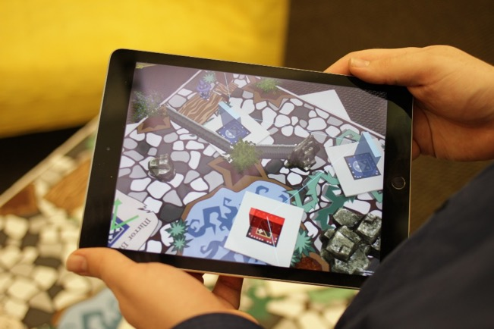
Shaping the Human Technology Frontier
Augmenting human capabilities
Wearable Computing
Mixed and Augmented reality
Human – Animal interaction
Arts and Technology
Universal Design & Assistive Technology

Slide 19
Shaping the Human Technology Frontier
Closing the Loop
HCC / Use / Adoption / Value
Policy
Immersive VR / AR training
Ebola care
GVU / IPaT seed grant
3D modeling for speech therapy
Future of sports and fan experiences
Braves in-situ AR experience
IPaT working group (Siva, Clint)
GVU 25
Grant for GVU 25 exhibition
GVU Tire tracks
Augmenting human capabilities
Wearable Computing
Mixed and Augmented reality
Human – Animal interaction
Arts and Technology
Universal Design & Assistive Technology

Slide 20
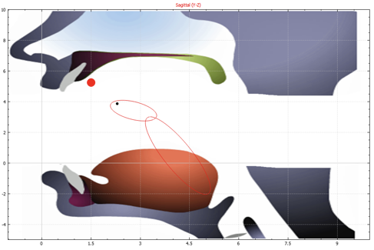
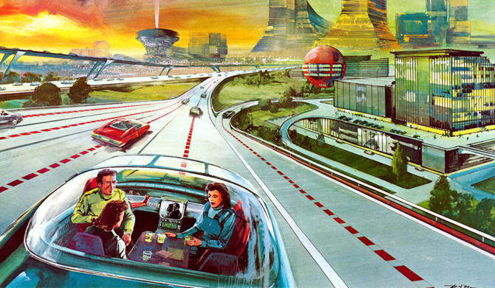
GVU / IPaT Research & Engagement Grants 💰💰
Toward Citizen-Centric Infrastructure IoT
Neda Mohammadi, Civil & Environmental Engineering
John Taylor, Civil & Environmental Engineering
Gisele Bennett, Electro-Optical Systems Lab, GTRI
All Data Are Local
Yanni Loukissas, Literature, Media and Communication
Real-Time Reconstruction and Visualization of
Tongue Motion for Speech Therapy
Karen Liu, Interactive Computing
Maysam Ghovanloo, Electrical and Computer Engineering
Nordine Sebkhi, Electrical and Computer Engineering
Local Data for Local Justice
Ellen Zegura, Computer Science
Amanda Meng, Computer Science
Russ Clark, Research Network Operations Center
Carl DiSalvo , Literature, Media, and Communication
Nostalgic Futures: 25 Years of Imagining Tomorrow
Clint Zeagler, Interactive Media Technology Center
Jay Bolter, Literature, Media, and Communication
Laura Levy, Interactive Media Technology Center
Maribeth Gandy, Interactive Media Technology Center

Slide 21
GVU 25
Wednesday October 18
Keynote Talk - Scott Hudson (CMU HCII)
GVU Impact Awards - once every five years!
Director’s Talk - Looking Back, Looking Ahead
Research Showcase - You can participate!!
  Special curated exhibit: Nostalgic Futures
  Special showcase of Georgia Tech exhibits from
  the ACC/Smithsonian Creativity Festival
GVU Student Awards Dinner
Thursday October 19
GVU Industry Advisory Board meeting
Distinguished Alum Brownbag - Jennifer Mankoff (UW)
Ashwin Ram - Alexa AI Manager @ Amazon
(and former GVU faculty)

Slide 22
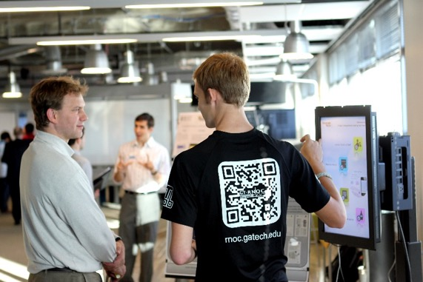
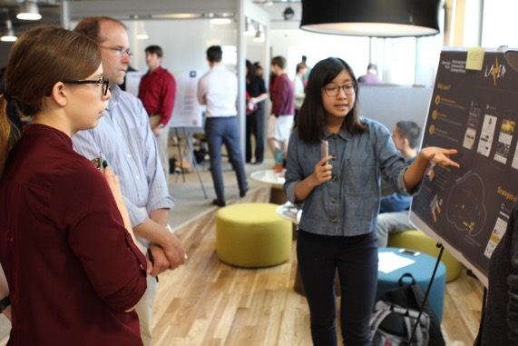
Convergence Innovation Competition
Bi-Annual competition
Over 100 students annually
2017 Fall CIC – November 15th
http://cic.gatech.edu/
Inspired by IPaT Research Pillars:
Smart Cities and IoT
Health and Wellbeing
Sports and Fan Experience
Arts and Culture
Onboarding sponsors right now!
Past sponsors include Verizon, AT&T, Cisco,
Code 42, and GM
Notes:
Life Long Health and Wellbeing
Entries in this category should focus on new or reimagined solutions for patients, communities, and/or those involved in the continuum of care (caregivers, doctors, hospitals, insurers, employers), and might address areas as diverse as chronic disease management; Health IT interoperability; analytics and decision support for quality; safety, and access to care; or advances in pediatric healthcare and healthy aging to name a few.
Smart Cities and Healthy Communities
Entries in this category should focus on solutions for individuals, communities, business and community stakeholders, and government service providers. Solutions might address inclusion, engagement, safety, efficiency, utility, policy, resilience, response, or anything which has the ability to improve the quality of life in communities. While some solutions in this space are geared towards integration of controls, sensors, analytics, and communication with physical elements or services deployed at scale. Other solutions might empower small communities to engage and have impact in novel and agile ways by leveraging, serving, and effecting community members directly.
Socio-Technical Systems and Human-Technology Frontier Innovation
Entries in this category will demonstrate new platforms, services, and devices ranging from the Internet of Things (IoT), Software Defined Networking (SDN), Automotive and Wearable Computing devices, Mixed and Augmented Reality, data science and analytics, collaboration and communication tools. While this category focuses on the technologies themselves entries are expected to demonstrate a viable application or service in order to be competitive.

Slide 23
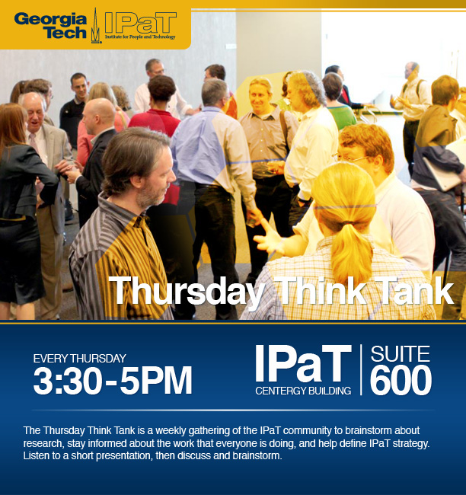
Thursday Think Tanks
The TTT is a weekly gathering
of the IPaT community to brainstorm about research,
stay informed about the work that everyone is doing, and
help define IPaT strategy.
Come interact with new and old colleagues and engage on topics of shared interest.
Save These Dates:
Sept 25
Oct 5, 12, 26
Nov 2, 9
email: ipat@gatech.edu

Slide 24
IPaT Capabilities and Support of the GT Research Community
Professional Staff
Marketing and Communications
Research Operations
Industry Partnerships
Space and Events (Don Schoner)
Grants and Finance (Diane Owen, Francine Lyken, Marcia Chandler)
Applied Research
Leigh McCook, Deputy Director (GTRI)
Research Network Operations Center (RNOC)
Interactive Media Technology Center (IMTC)
email: ipat@gatech.edu

Slide 25
IPaT Marcom
Alyson Powell

Slide 26
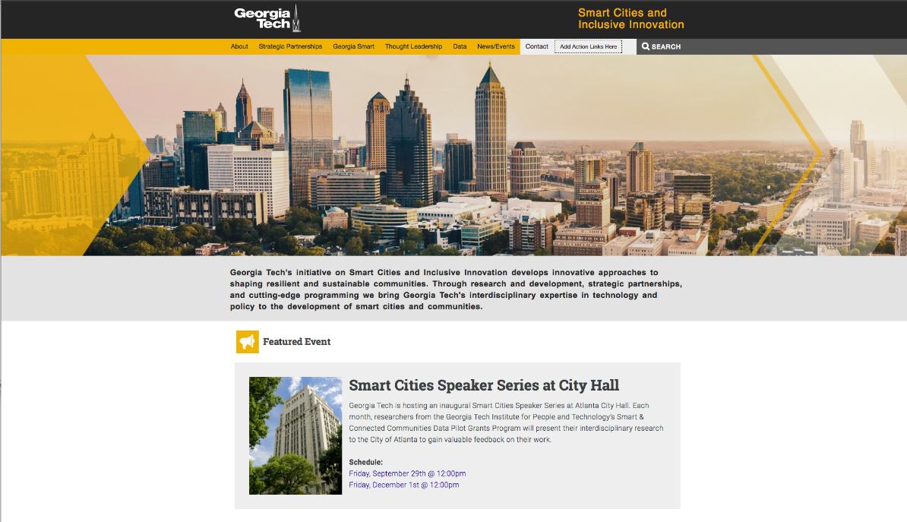
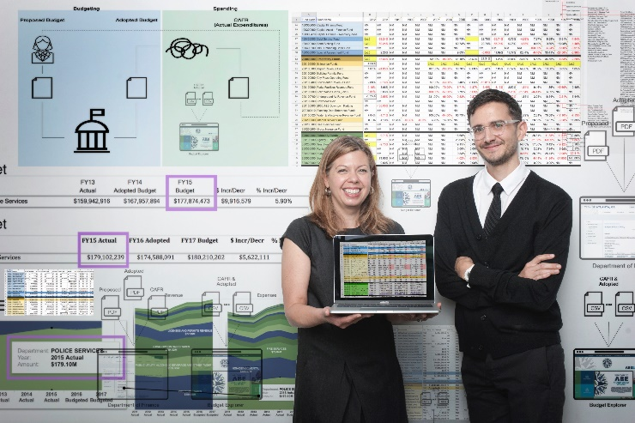

IPaT Marcom Priorities:
Smart Cities and Inclusive Innovation
Website
Event support
Marketing materials
Communication
IPaT In-Depth

Slide 27
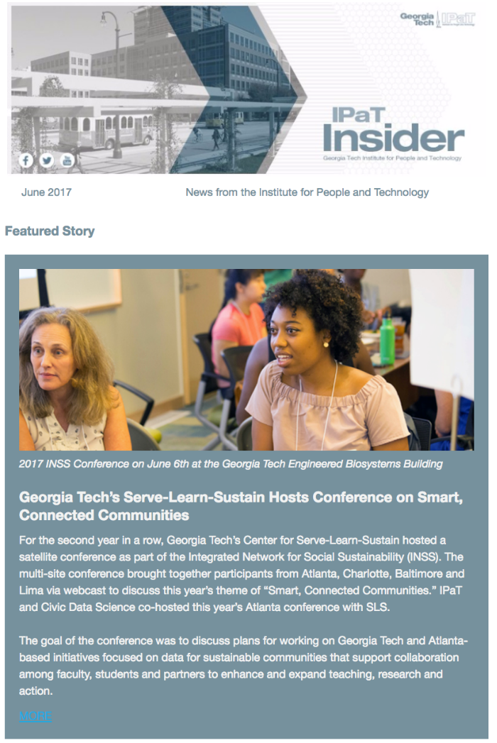

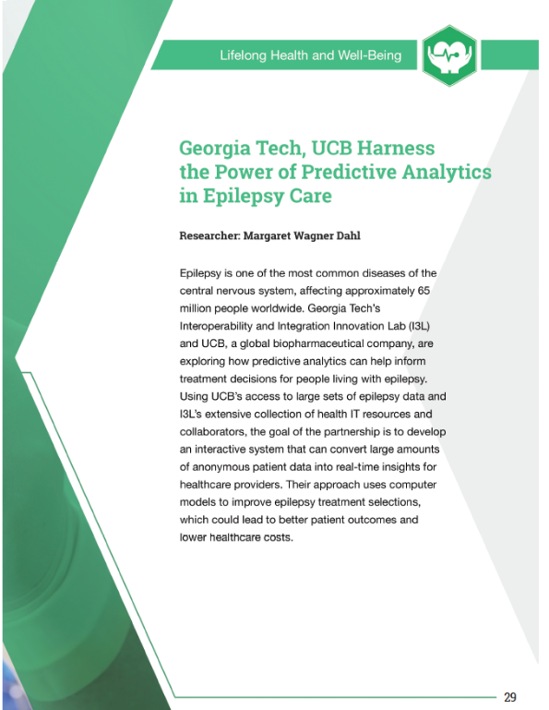
IPaT Marcom Priorities : Publications
IPaT Highlights : Weekly
IPaT Insider : Monthly
Triennial Publications
  Platforms & Tools Catalog
  Impact Report
  Research Abstracts

Slide 28
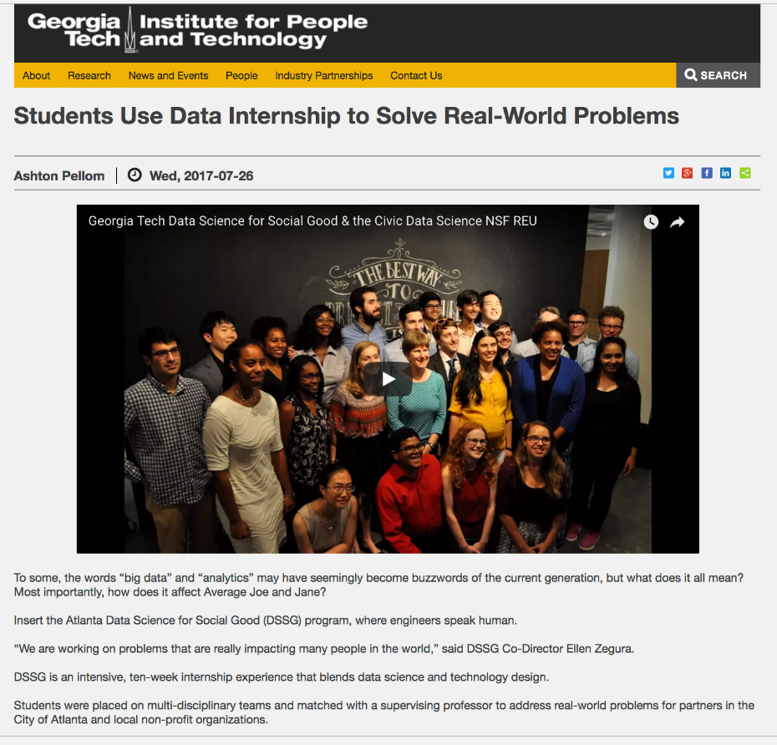
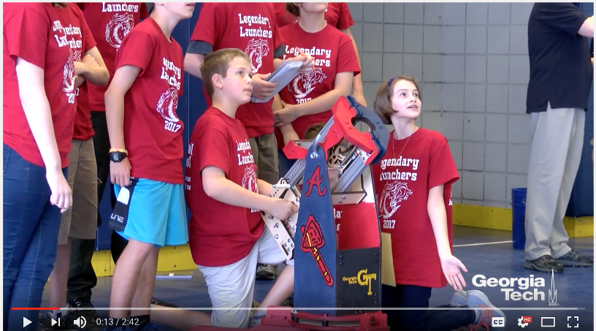

IPaT Marcom Priorities
Collaboration
Pediatric Technology Center
CEISMC
IISP
Data Science for Social Good
GTRI
College of Computing
GVU Center

Slide 29
IPaT Research Operations
Richard Starr
(Matt Sanders)

Slide 30

Research Operations Priorities for 2017
Platforms
  PHDI – web services, ETL & database improvements,
  automated imports & monitoring
  Server/storage – upgrades, site redundancy
  + space for smart cities data
  Containerization - RNOC/m.gatech, I3L
Compliance
  HIPAA HITRUST
  NIST 800-171
  CMS DUA changes
IT Goodness
  AV improvements – Midtown Collaborative, Burdell Cleanup,
  Web conferencing
  Aware Home – network upgrades
  TSRB – Applab + Motion Capture Lab construction/consolidation
  Web site standardization
Notes:
Need some visual treatment here

Slide 31
IPaT Strategic Partnerships
Siva Jayaraman

Slide 32
Strategic Partnerships – How does it work
Work with larger GT community
  Development office
  IRI primes for partnerships & development
  School/College primes
  Industry Leadership Council
  GTRC – Contracting, licensing etc.
  Legal – NDAs etc
Identify and cultivate new partners
Maintain current/past partners
  Communicate constantly
  Pivots in strategy
  New engagements

Slide 33
Strategic Partnerships Priorities
Continuous conversations
  Monthly dev meetings
    Starting September
    Each week – 1 pillar
  Get any CMS going!
New Initiatives and New Partnerships
  Sports/Esports
  FinTech
  Health Analytics
Convergence Innovation Competition (CIC)
  Categories announced
  Securing internal and external sponsors and partners
Spread the Word
  More representation & participation

Slide 34
GTRI
Leigh McCook (ICL)

Slide 35
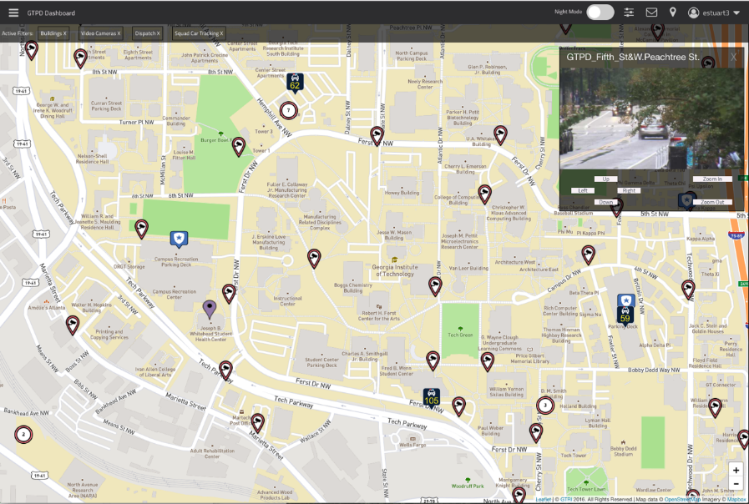
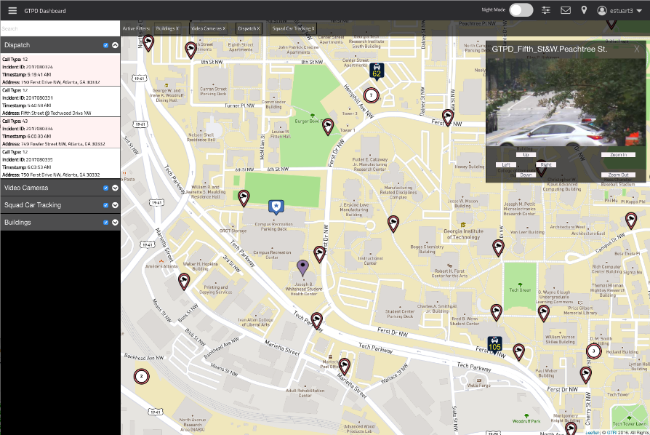
GTRI Priorities : Recent and Ongoing Collaborations
Health and Humanitarian Systems
  CDC Mixed Mobile Media Survey Platform
  (McCook, Mulkey, Lie-Tjauw)
  CDC Data Visualization
  DFCS Safe Habor Development
  (Mulkey, Jerem, IMTC)
  TEFT (Owens, IMTC)
  HomeLab Projects (Fain, Farmer, IMTC)
  HITRUST Certification (Dunham, Sanders, RNOC)
  CHOA Quickwins (Owens): IMLAY, MRI,
  Bowel Management
  FHIR Support (Braunstein Class, TEFT)
Smart Cities
  City of Atlanta Collaborations
  (Lam, Doyle, McCook)
  GTPD COP (Stuart, McCook, ISyE)
  Participation in Smart Cities Workshops
  Coming: Public Safety and Smart Cities
  Spring Forum (Lam, McCook)

Slide 36
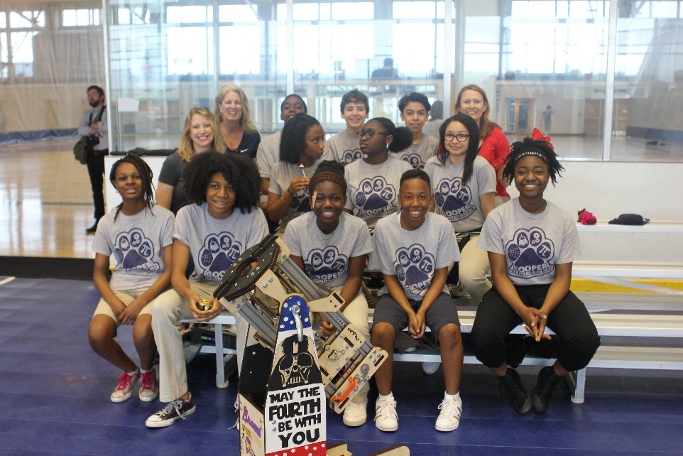
GTRI Priorities
IPaT/GVU/GTRI Seed Grant – Smart Cities
  Toward Citizen-Centric Infrastructure IOT
  Neda Mohammadi, Civil & Enviornmental Engineering
  John Taylor, Civil & Environmental Engineering
  Gisele Bennett, Electro-Optical Systems Lab, GTRI
STEM/CEISMC Collaborations
  STEM Literacy
  Professional Development Series
  for Computer Science
  Braves STEM Partnership
  Dobbins Air Show (March 2018)
  Proposal Development with Industry
  Joint Outreach Planning
  Internships
  You Tube Video Series – Showcasing
  Cool Research for MS/HS Applications

Slide 37
RNOC
Russ Clark
(Matt Sanders)

Slide 38

RNOC Priorities
Smart Campus
  Facilities data – with Auxiliary Services and OIT
  Location and occupancy
  On-line APIs and long term data
  Platform architectural improvements
IoT Testbed
  Low power, wireless infrastructure –
  operational across campus
  Storage, messaging, and analytics capabilities
Student Engagement
  CIC – Atlanta and GT Lorraine
  Courses in Atlanta, GTL and Panama
  Professional Education - CDAIT, Savannah
  Entrepreneurship and civic engagement – TAG,
  SandBox, MakerFaire, Meetup groups
Notes:
Need some visual treatment here

Slide 39
Interactive Media Technology Center (IMTC)
Maribeth Gandy

Slide 40

IMTC Priorities
Catalyze (enabling and amplifying academic research)
Industry often focuses on technology solutions
IMTC/RNOC can be solution/technology agnostic
Perform problem discovery and user needs analysis
Form interdisciplinary teams from across campus
    Collaborations with academic faculty are top priority
    Define project funding/scope appropriately
Continuity (supporting ambitious research threads and tech transfer)
  Across phases of projects
  (discovery, design, implementation, evaluation, deployment, support)
  Between projects (reusable platforms, processes, personnel)
  Long term collaborations with academic faculty and their students
  Connection to IPaT research pillars, vision and mission
Notes:
Need some visual treatment here

Slide 41
IMTC Priorities : Key Research Threads
  mHealth solutions for Precision Medicine
    Many ongoing collaborations with CoC (e.g. Mynatt, Arriaga), Emory, GTRI
  Novel sensor design and machine learning techniques
    Sensing in elevators (TKE)
    Monkey behavior (NSF with Tucker Balch, IC)
  Novel feedback from assessment systems
    Guiding workers to appropriate contract jobs (Lateshift)
    Supporting students exploring education and career paths
    (ACT Inc.)
  AR/VR for training
    Team training in OR (Emory)
    Spill cleanup for infectious disease (Emory)
  User-centered design of wearable I/O
    Techniques for design processes and user evaluation
    Assistive tech (Wireless RERC)
    TB screening technology in Uganda
    Sports tech (GTAA, Braves)
  The user experience of IoT
    AwareHome Connected Life initiatives (Flex)
    Interdisciplinary teams from Psych, CoC, RNOC, PubP, COA, Eng, GTRI/CDAIT
    Smart Cities connection
Notes:
Need some visual treatment here

Slide 42
IPaT Fall Schedule
Hosted by Research Centers
GVU 25 Oct 18-19
GTRI Public Safety Forum TBD 2018
Thursday Think Tanks
Thursdays, 3:30-5pm
Sept 25; Oct 5, 12, 26; and Nov 2, 9
IPaT Living Labs Seminars
Fridays, 12-1pm
IPaT All Hands Aug 15; Dec TBD
Convergence Innovation Competition (CIC) Nov 15
Annual Holiday Luncheon Dec TBD
IPaT Research Directors Sept 19, Oct 5, Nov 9
8:30-10am

Slide 43

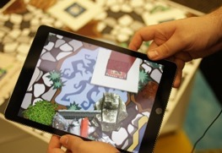
IPaT’s Vision, Mission and Research Pillars
Shaping the future of
human-centered systems, environments and technologies to promote satisfying, healthy and productive lives.
Research Pillars
Lifelong Health and Wellbeing
Smart Cities and Inclusive Innovation
Platforms and Services for Socio-Technical Systems
Shaping the Human Technology Frontier
Catalyze interdisciplinary research between faculty, students, and industry.
Provide the continuity and capacity to address societal challenges.
Advocate for socio-technical
change that improves the
human condition.
Educate human-centered engineers, scientists, designers, business leaders, and policy makers.

